Slide 1
The predictability of life course
Applied Statistics Project
Students
MASSIN Keryann
VEILLON Juliette
ANDRU Kilian
LACOUR Xavier
Supervisors
M. TROPF Felix
M. PETEV Ivaylo

Slide 2
Summary
I – Introduction
II – Data cleaning
III – Creation of the Health Index
IV – First machine learning procedures
V – Second machine learning procedures
VI - Conclusion

Slide 3
I – Introduction

Slide 4
II – Data cleaning

Slide 5
III – Creation of the Health Index

Slide 6

IV – First machine learning procedures
$n≈p$ $⇒$ Standard methods would not converge
Idea: Select $p^{′}≪p$ predictors beforehand
How? Lasso
Problem: a lot of missing data
Solution: modified version of the Lasso

Slide 7
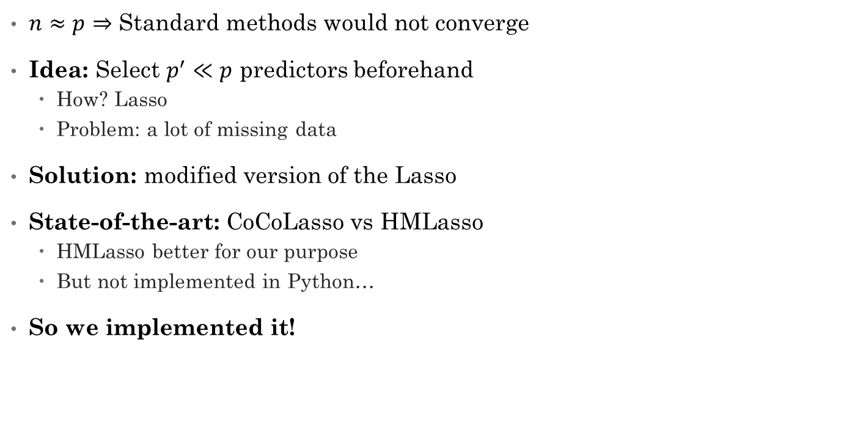
IV – First machine learning procedures
$n≈p$ $⇒$ Standard methods would not converge
Idea: Select $p^{′}≪p$ predictors beforehand
How? Lasso
Problem: a lot of missing data
Solution: modified version of the Lasso
State-of-the-art: CoCoLasso vs HMLasso
HMLasso better for our purpose
But not implemented in Python…
So we implemented it!

Slide 8
IV – First machine learning procedures
HMLasso in Python
CVXPY library → solver
Scikit-learn like interface
Useful to select predictors

Slide 9
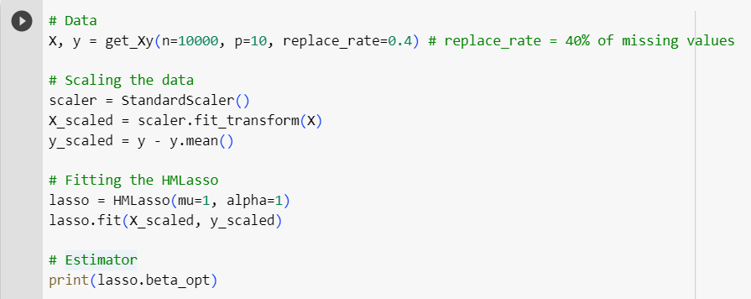
IV – First machine learning procedures
HMLasso in Python
CVXPY library → solver
Scikit-learn like interface
Useful to select predictors
We can drop columns 6 and 9

Slide 10

IV – First machine learning procedures
HMLasso in Python
CVXPY library → solver
Scikit-learn like interface
Useful to select predictors
On our data, huge gain
$p=4, 147⇒p^{′}=1500$
We can drop columns 6 and 9

Slide 11
V – Second machine learning procedures
Two kind of methods
Linear methods:
2SLS
Within regression
Tree Based Methods:
XGBoost
RandomForest

Slide 12
V – Second machine learning procedures Linear methods – 2SLS

Slide 13
V – Second machine learning procedures Linear methods – Within Regression

Slide 14
V – Second machine learning procedures Tree Based methods – XGBoost
Fragile Family Challenge: XGBoost provided powerful results
Let’s give it a try!
What is it?
Gradient Boosting Method

Slide 15
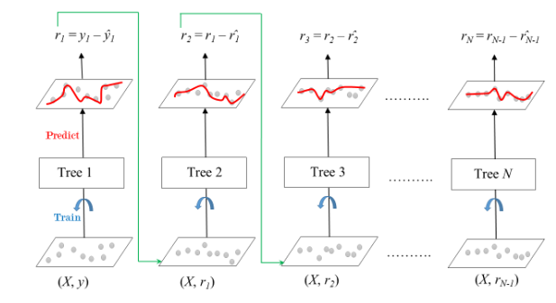

V – Second machine learning procedures Tree Based methods – XGBoost
Fragile Family Challenge: XGBoost provided powerful results
Let’s give it a try!
What is it?
Gradient Boosting Method
Idea: greedily construct
$f\left(x\right)=\sum_{i≤N}{{Tree}_{i}\left(x\right)}$
XGBoost: algorithm of
Gradient Boosting that handle
missing values
Run extremely fastly!
Source: https://www.geeksforgeeks.org/ml-gradient-boosting/

Slide 16
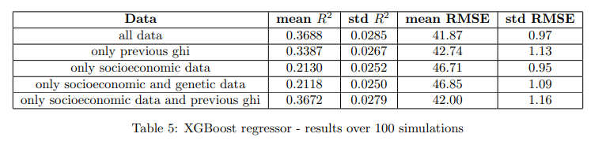
V – Second machine learning procedures Tree Based methods – XGBoost
On our data
Regression
Optimized hyperparameters using cross-validation
Results:
Good results!
Unable to identify the effect of genetic variables

Slide 17
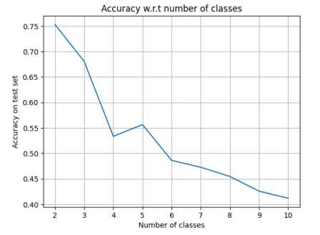

V – Second machine learning procedures Tree Based methods – XGBoost
On our data
Regression $⇒$ what about classification?
Is GHI = 99 really worse than GHI = 100?
For 2 categories {bad health, good health},
75,31% of accuracy
1,51 times better than dummy classifier
For 10 categories,
41,21% of accuracy
4,12 times better than dummy classifier!

Slide 18
V – Second machine learning procedures Tree Based methods – Random Forest
Boosting works. What about bagging?
Random Forest vs Gradient Boosting

Slide 19


V – Second machine learning procedures Tree Based methods – Random Forest
Boosting works. What about bagging?
Random Forest vs Gradient Boosting
What is it?
Idea: parallelise the training of decision trees
Wisdom of crowds $⇒$ Majority-voting to predict
a class
How? Database boostrap
Source: https://en.wikipedia.org/wiki/Random_forest

Slide 20
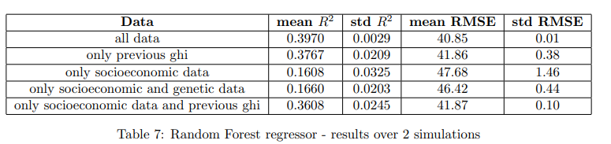
V – Second machine learning procedures Tree Based methods – Random Forest
On our data
Regression
Optimized hyperparameters using cross-validation
Results:
Strong prediction power!

Slide 21
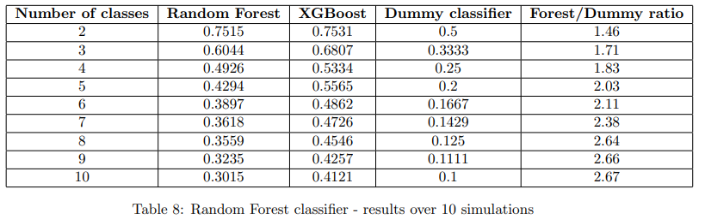
V – Second machine learning procedures Tree Based methods – Random Forest
On our data
Classification
Results:
Random Forest < XGBoost

Slide 22
VI - Conclusion

